Slide 1
Excel Assignment II
Saurabh Jadhav

Slide 2
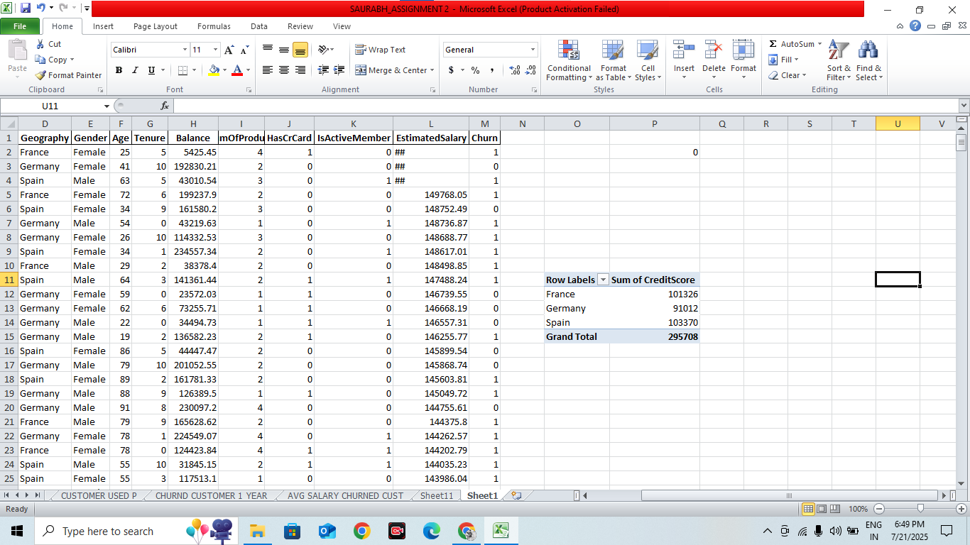
Please address the following analytical questions using Pivot Tables in Excel:
Q1. What is the average credit score for each geography?

Slide 3
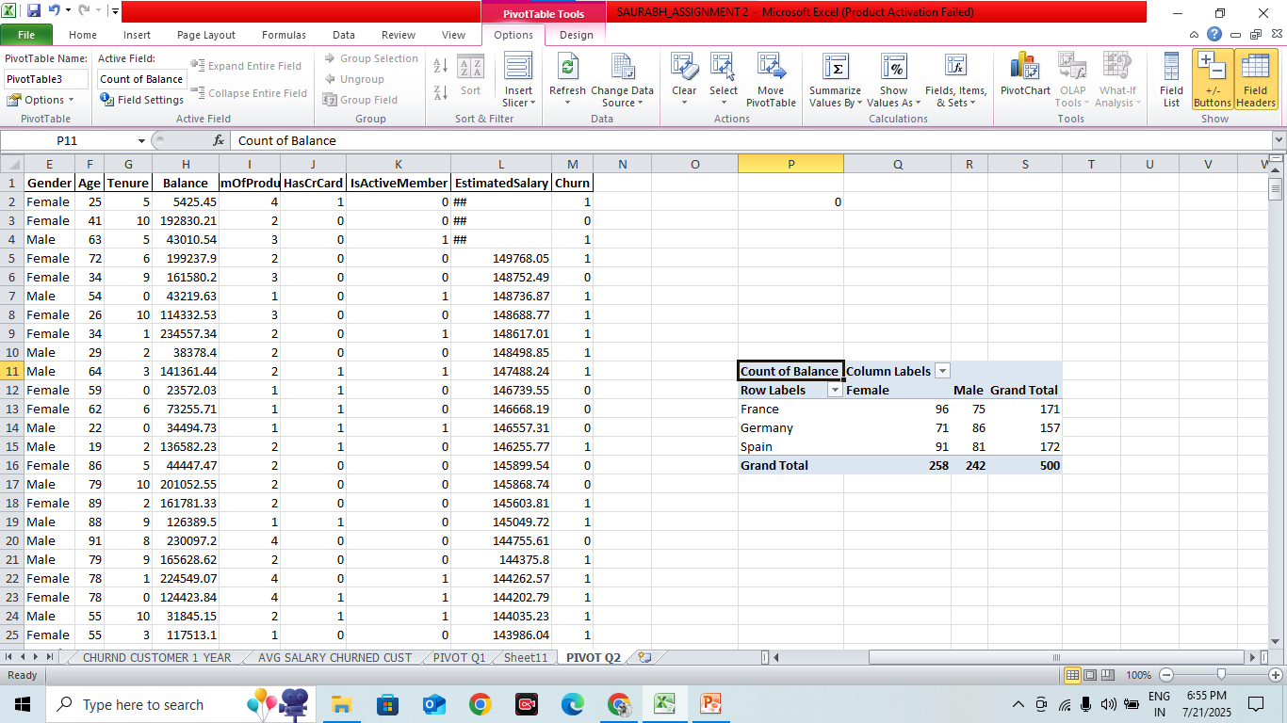
How does the average account balance vary between genders within each country?

Slide 4
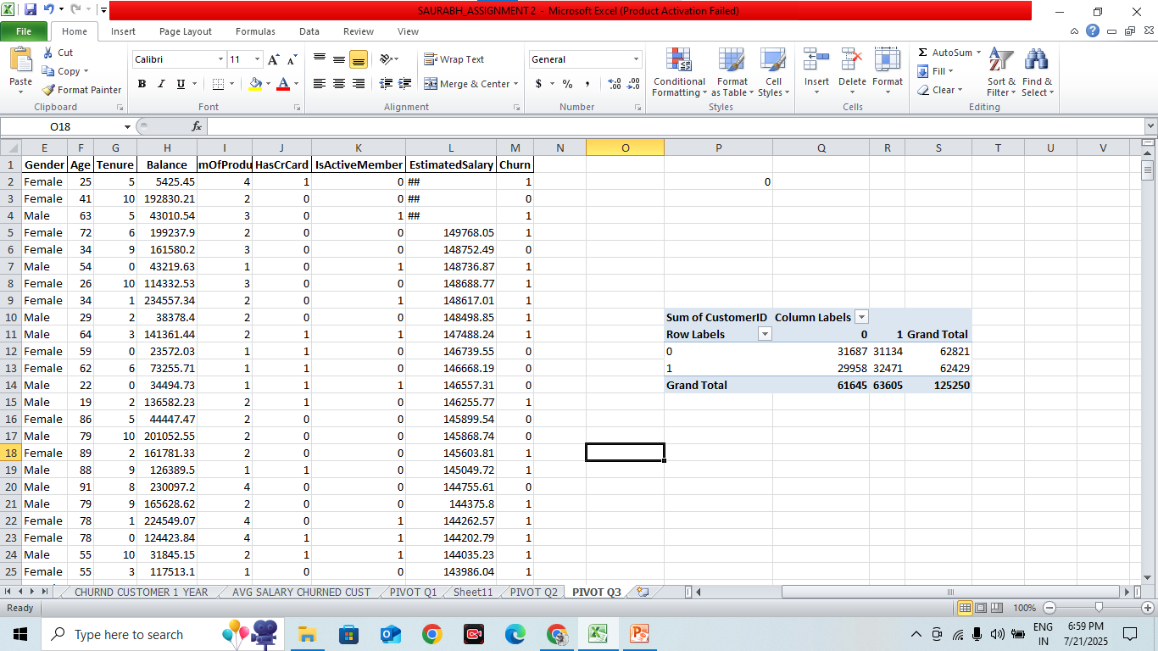
Q3. What is the distribution of active vs non-active members according to having a credit card?

Slide 5
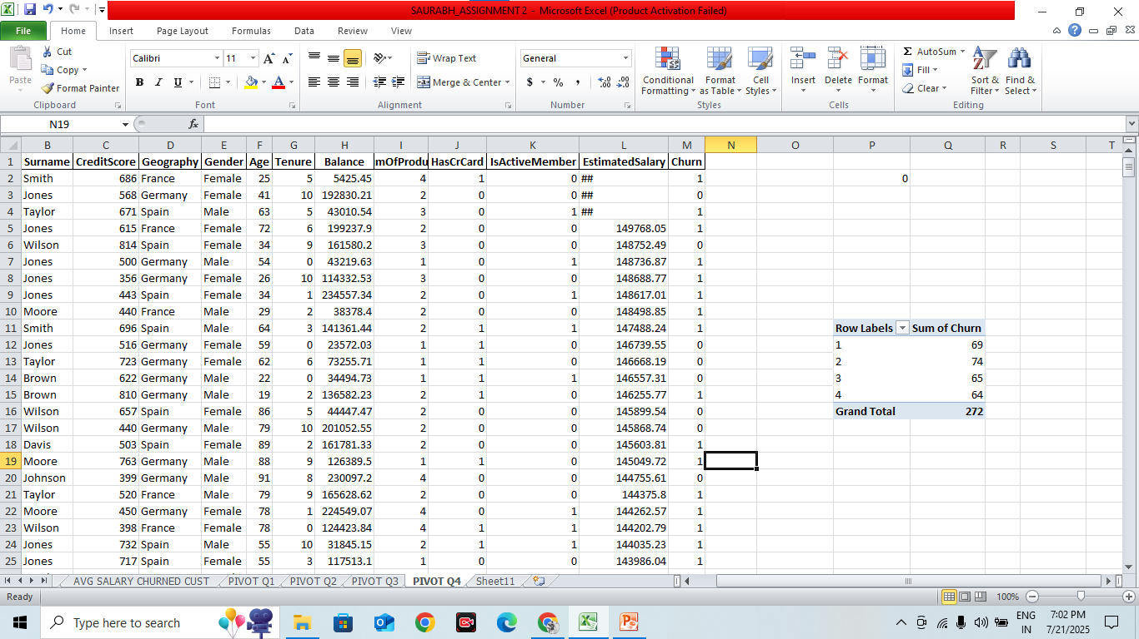
Q4. What is the customer churn rate per number of products used?

Slide 6
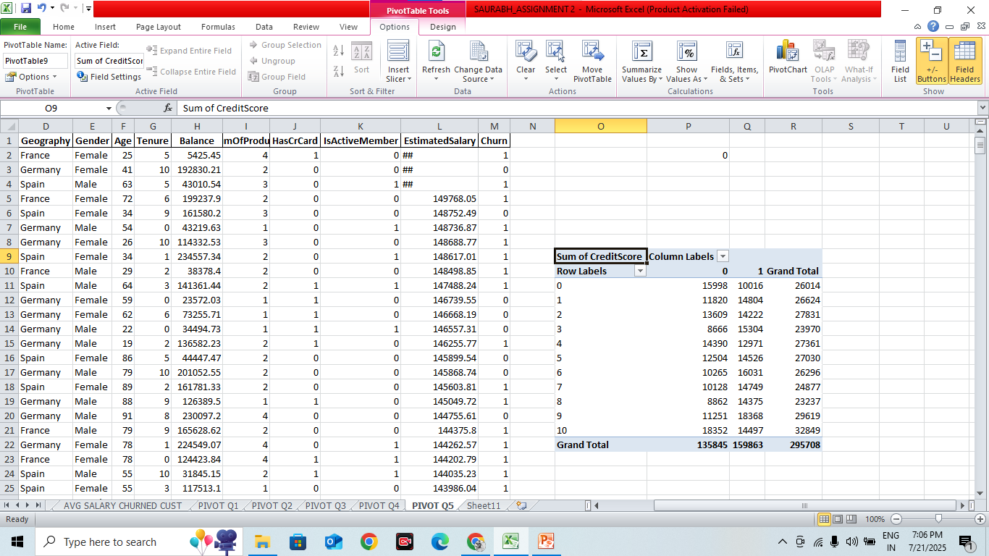
Q5. What is the average credit score for customers who have exited compared to those who have stayed, across different tenures?

Slide 7
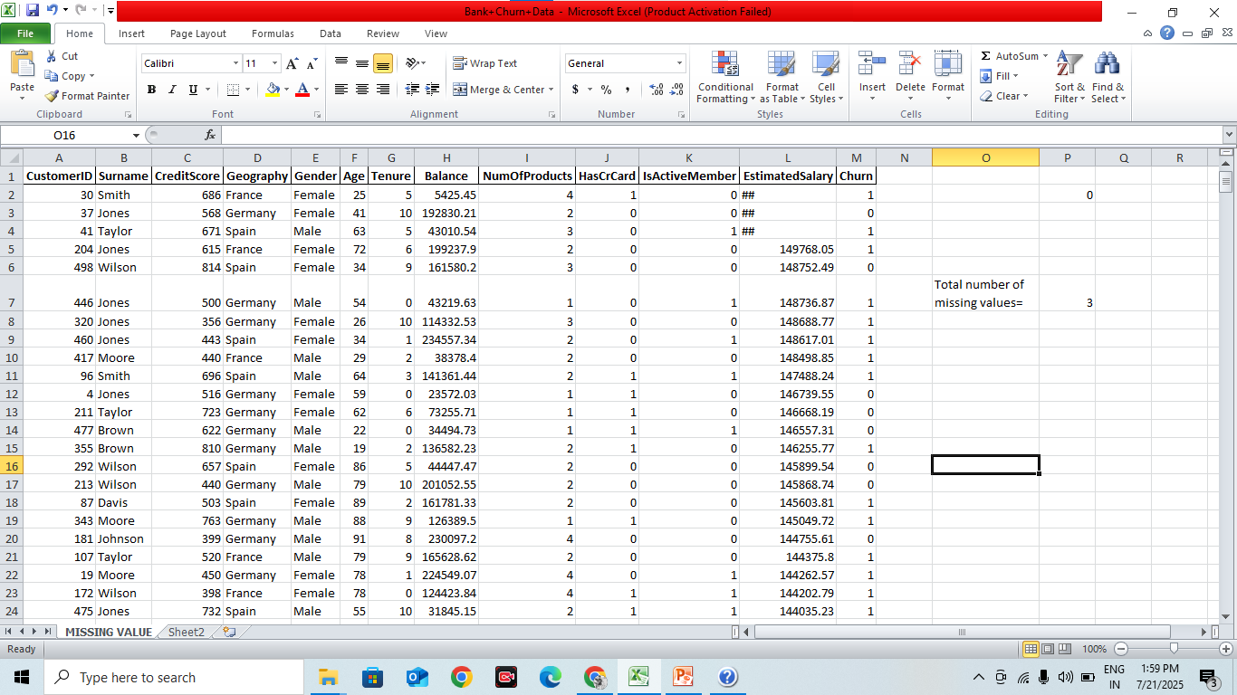
Q1. How many missing values are in the "EstimatedSalary" variable = 3

Slide 8
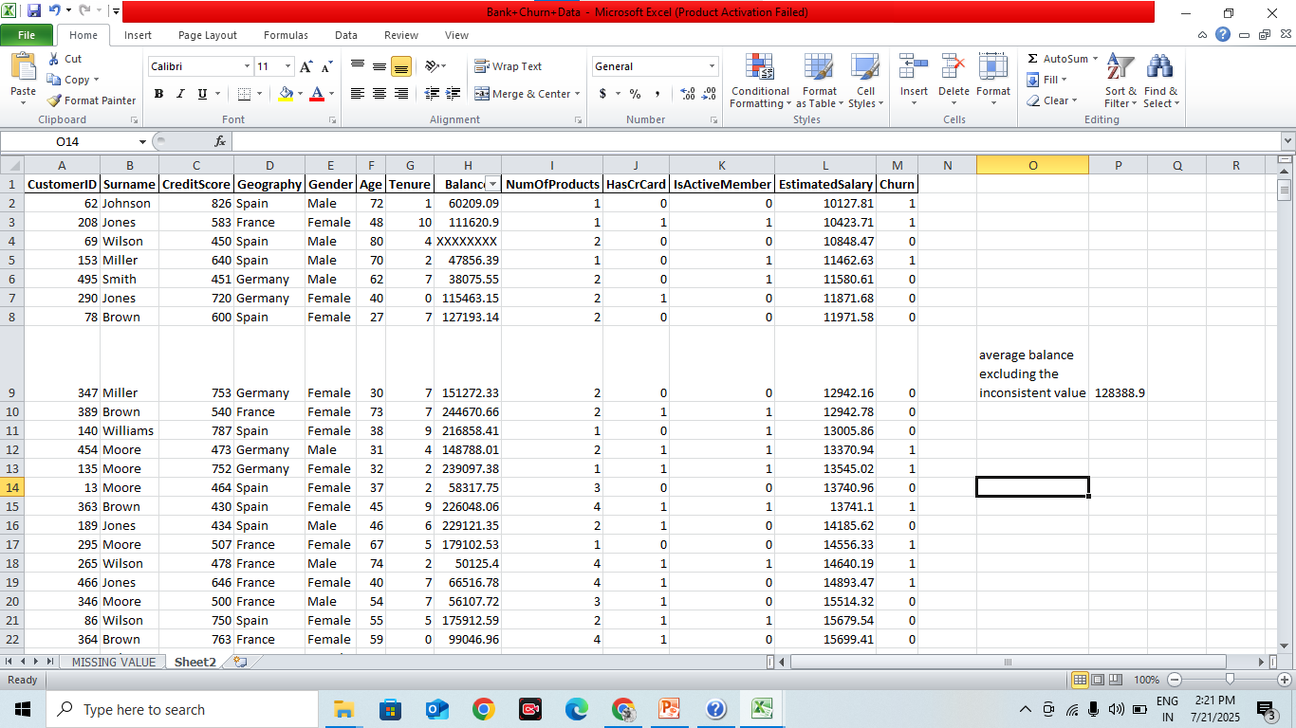
Q2. What is the average balance excluding the inconsistent value = ₹128,678.99

Slide 9

Q3. What is the average credit score of the customers from Germany = 579.694

Slide 10
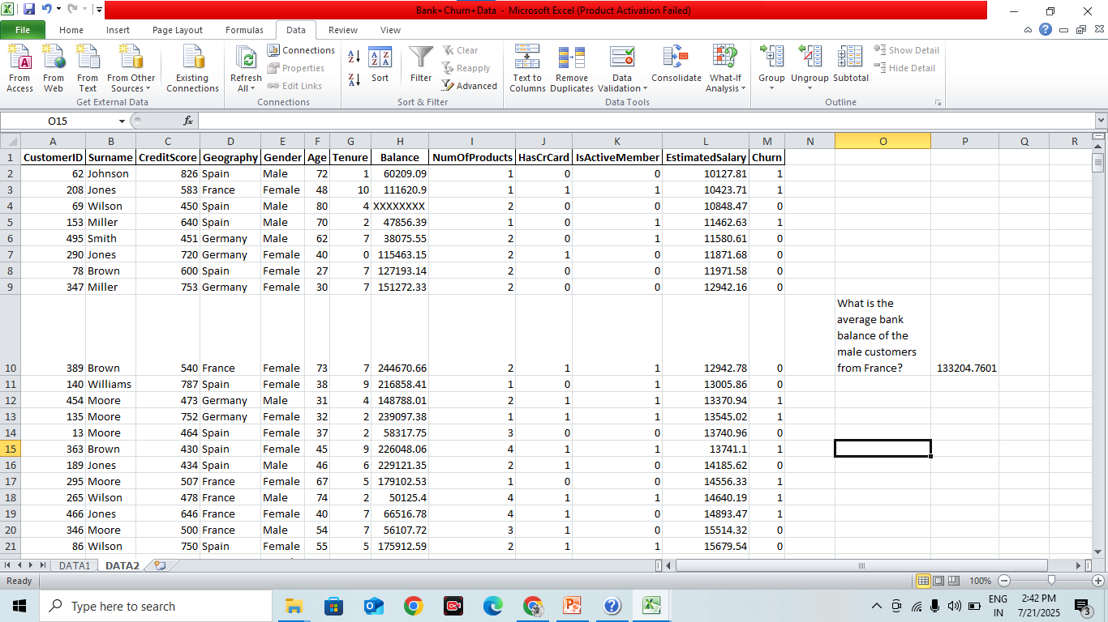
Q4. What is the average bank balance of the male customers from France= 133204.76

Slide 11
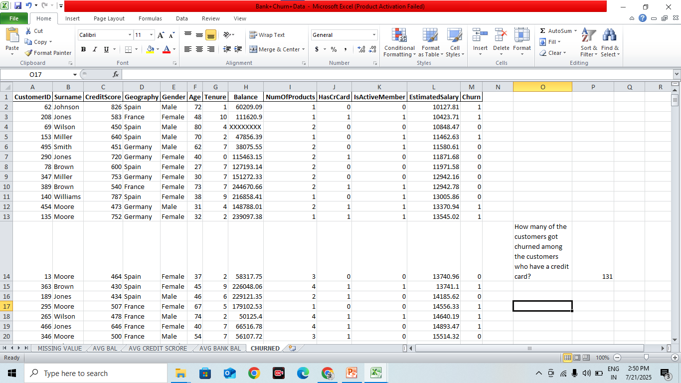
Q5. How many of the customers got churned among the customers who have a credit card= 131

Slide 12
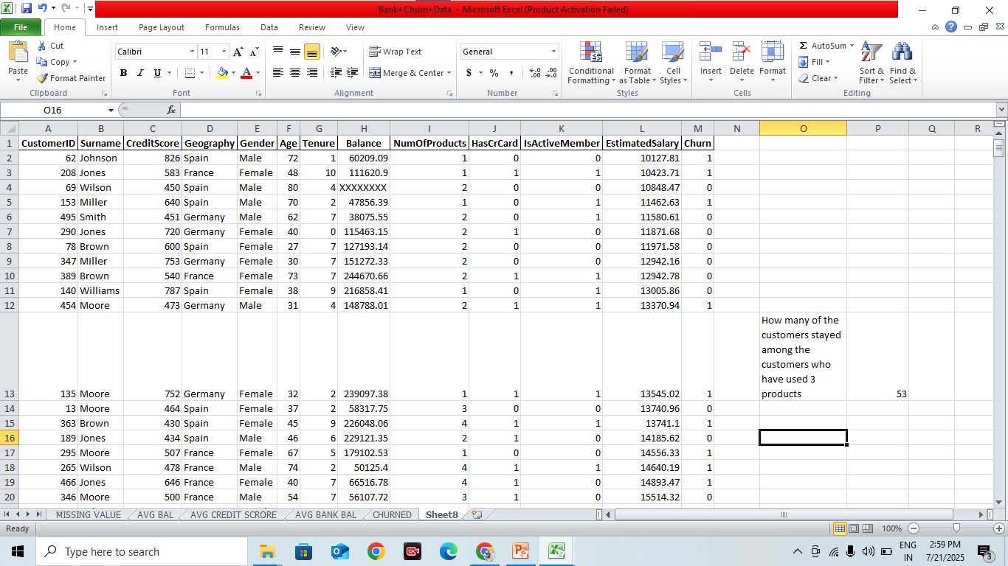
Q6. How many of the customers stayed among the customers who have used 3 products= 53

Slide 13
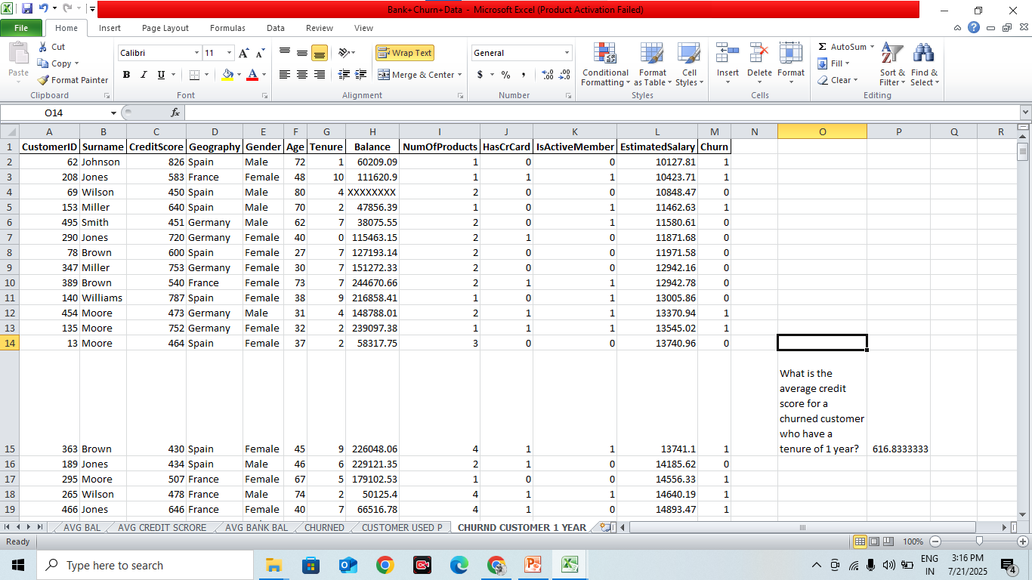
Q7. What is the average credit score for a churned customer who have a tenure of 1 year= 616.83

Slide 14
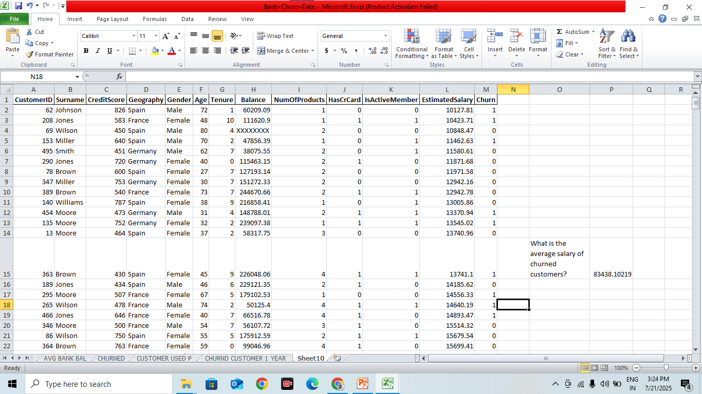
Q8. What is the average salary of churned customers? = 83438.1021

Slide 15
Q9. What is the conclusion for the research question 1?
-There are 3 missing values in the EstimatedSalary field. These need to be handled (either by imputation or exclusion) before performing any statistical analysis involving salary data to maintain accuracy.

Slide 16
Q10. What is the conclusion for the research question 2?
After excluding inconsistent or outlier values, the average balance is ₹128,678.99. This cleaned figure represents a more reliable view of the customers' financial standing compared to using the raw data.

